Slide 1
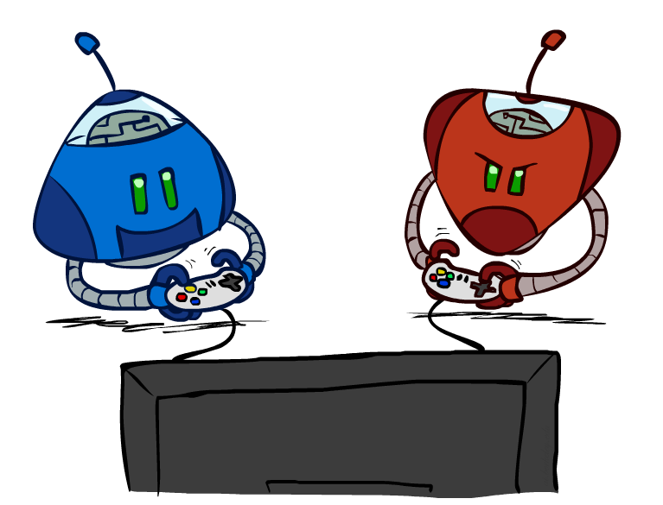
CS 188: Artificial Intelligence
Adversarial Search II
Instructors: Stuart Russell and Dawn Song
University of California, Berkeley
Notes:
Please retain proper attribution and the reference to ai.berkeley.edu. Thanks!

Slide 2
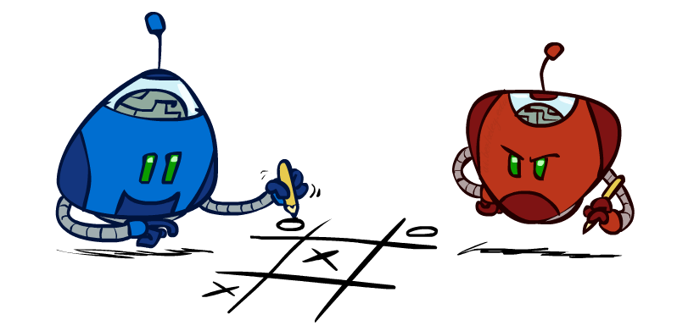
Outline
Finite lookahead and evaluation
Games with chance elements
Monte Carlo tree search

Slide 3
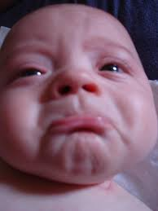
The story so far…
Focus on two-player, zero-sum, deterministic, observable, turn-taking games
Minimax defines rational behavior
Recursive DFS implementation: space complexity O(bm), time complexity O(b^{m})
Alpha-beta pruning with good node ordering reduces time complexity to O(b^{m/2})
Still nowhere close to solving chess, let alone Go or StarCraft

Slide 4

Resource Limits

Slide 5
Resource Limits
Problem: In realistic games, cannot search to leaves!
Solution (Shannon, 1950): Bounded lookahead
Search only to a preset depth limit or horizon
Use an evaluation function for non-terminal positions
Guarantee of optimal play is gone
Example:
Suppose we can explore 1M nodes per move
Chess with alpha-beta, 35^{(8/2)} =~ 1M; depth 8 is quite good
max
4
-2
4
min
-1
-2
4
9
?
?
?
?

Slide 6

Pacman with Depth-2 Lookahead
Notes:
Depth 2, one dot and two ghosts; dot is about 8 steps away – cannot see actual eating, so need to include distance to dots in eval; but limited depth means it goes into a dead end and cannot escape even a simple ghost strategy;

Slide 7
Pacman with Depth-10 Lookahead
Notes:
Perfect lookahead: head towards red ghost!!! Wait for blue to commit to one pursuit direction, go the other way, eat the dot
Note also the horror you feel: humans would take the safer strategy of waiting, not heading for blinky; minimax doesn’t care. WHY? It is 100% certain its theory of the world is correct

Slide 8
Evaluation Functions
Evaluation functions score non-terminals in depth-limited search
Typically weighted linear sum of features:
EVAL(s) = w₁ f₁(s) + w₂ f₂(s) + …. + w_{n} f_{n}(s)
E.g., w₁ = 9, f₁(s) = (num white queens – num black queens), etc.
Or a more complex nonlinear function (e.g., NN) trained by self-play RL
Terminate search only in quiescent positions, i.e., no major
changes expected in feature values

Slide 9
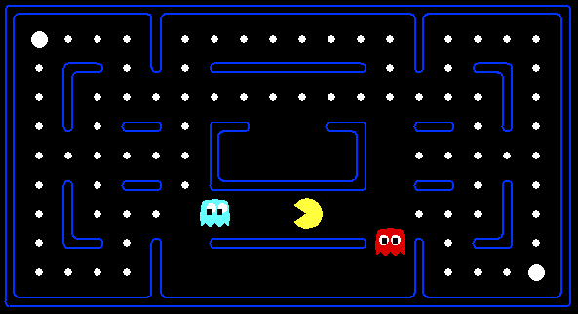




Evaluation for Pacman

Slide 10
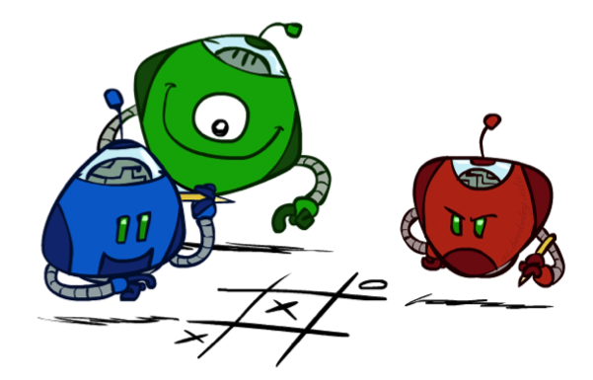
Generalized minimax
What if the game is not zero-sum, or has multiple players?
Generalization of minimax:
Terminals have utility tuples
Node values are also utility tuples
Each player maximizes its own component
Can give rise to cooperation and
competition dynamically…
8,8,1
8,8,1
7,7,2
0,0,7
8,8,1
7,7,2
0,0,8
1,1,6
0,0,7
9,9,0
8,8,1
9,9,0
7,7,2
0,0,8
0,0,7
Notes:
If both ghosts go the same way, pacman wins; if they go different ways, pacman loses

Slide 11
Emergent coordination in ghosts
Notes:
Two ghosts equipped with minimax: pacman gets his head handed to him. EVAL includes closeness to pacman, but final surrounding move due to terminal states.
This could be done with two-ghost state but is actually a three-player minimax with both ghosts using min; i.e., coordination emerges (usually!)

Slide 12
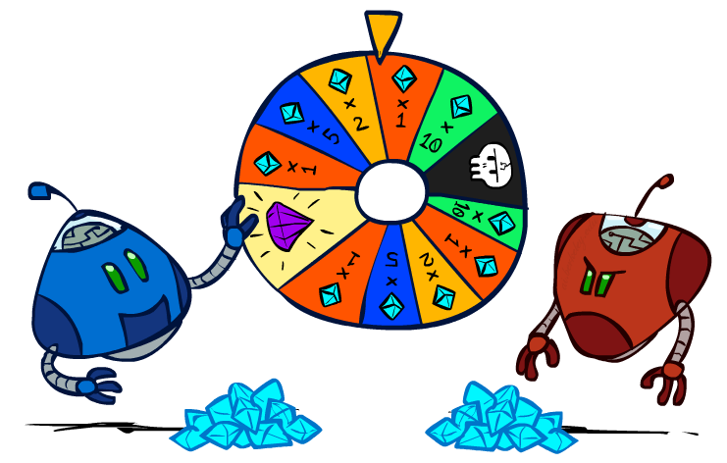
Games with uncertain outcomes
Notes:
Please retain proper attribution and the reference to ai.berkeley.edu. Thanks!

Slide 13
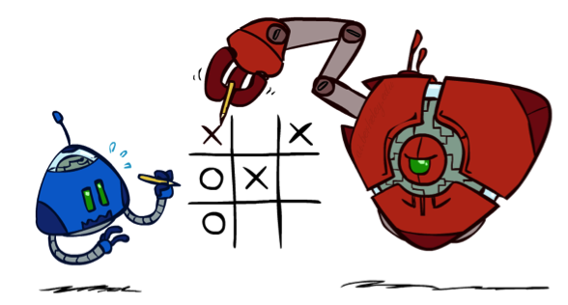
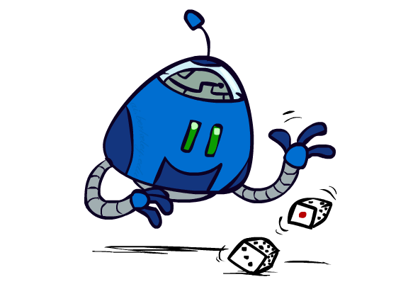

Chance outcomes in trees
10
10
9
100
10
10
9
100
Tictactoe, chess
Minimax
Tetris, investing
Expectimax
10
9
10
9
10
100
Backgammon, Monopoly
Expectiminimax
Notes:
At least 10, or otherwise just rather dead; or just 100, or otherwise rather dead; that’s yet something different than minimax or expectimax

Slide 14
Minimax
function decision(s) returns an action
return the action a in Actions(s) with the highest minimax_value(Result(s,a))
function minimax_value(s) returns a value
if Terminal-Test(s) then return Utility(s)
if Player(s) = MAX then return max_{a in Actions(s)} minimax_value(Result(s,a))
if Player(s) = MIN then return min_{a in Actions(s)} minimax_value(Result(s,a))
Notes:
Note that “minimax-decision” has become just “decision”

Slide 15
Expectiminimax
function decision(s) returns an action
return the action a in Actions(s) with the highest value(Result(s,a))
function value(s) returns a value
if Terminal-Test(s) then return Utility(s)
if Player(s) = MAX then return max_{a in Actions(s)} value(Result(s,a))
if Player(s) = MIN then return min_{a in Actions(s)} value(Result(s,a))
if Player(s) = CHANCE then return sum_{a in Actions(s)} Pr(a) * value(Result(s,a))
Notes:
Note that “minimax-decision” has become just “decision”

Slide 16
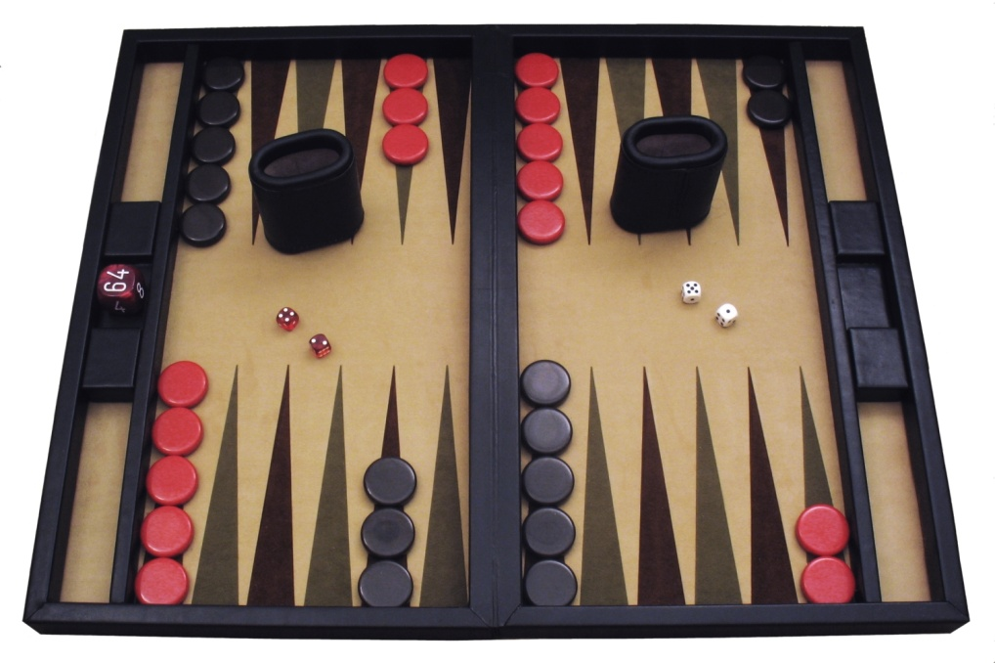
Example: Backgammon
Dice rolls increase b: 21 possible rolls with 2 dice
Backgammon ≈ 20 legal moves
4 plies = 20 x (21 x 20)³ = 1.2 x 10⁹
As depth increases, probability of reaching a given search node shrinks
So usefulness of search is diminished
So limiting depth is less damaging
But pruning is trickier…
Historic AI: TDGammon uses depth-2 search + very good evaluation function + reinforcement learning: world-champion level play
Image: Wikipedia

Slide 17
What Values to Use?
0
40
20
30
x²
0
1600
400
900
x>y => f(x)>f(y)
f(x) = Ax+B where A>0
For worst-case minimax reasoning, evaluation function scale doesn’t matter
We just want better states to have higher evaluations (get the ordering right)
Minimax decisions are invariant with respect to monotonic transformations on values
Expectiminimax decisions are invariant with respect to positive affine transformations
Expectiminimax evaluation functions have to be aligned with actual win probabilities!

Slide 18


Slide 19
Monte Carlo Tree Search
Methods based on alpha-beta search assume a fixed horizon
Pretty hopeless for Go, with b > 300
MCTS combines two important ideas:
Evaluation by rollouts – play multiple games to termination from a state s (using a simple, fast rollout policy) and count wins and losses
Selective search – explore parts of the tree that will help improve the decision at the root, regardless of depth

Slide 20
Rollouts
“Move 37”
For each rollout:
Repeat until terminal:
Play a move according to a fixed, fast rollout policy
Record the result
Fraction of wins correlates with the true value of the position!
Having a “better” rollout policy helps

Slide 21
MCTS Version 0
Do N rollouts from each child of the root, record fraction of wins
Pick the move that gives the best outcome by this metric
57/100
39/100
65/100

Slide 22
MCTS Version 0
Do N rollouts from each child of the root, record fraction of wins
Pick the move that gives the best outcome by this metric
57/100
0/100
59/100

Slide 23
MCTS Version 0.9
Allocate rollouts to more promising nodes
77/140
0/10
90/150

Slide 24
MCTS Version 0.9
Allocate rollouts to more promising nodes
61/100
6/10
48/100

Slide 25
MCTS Version 1.0
Allocate rollouts to more promising nodes
Allocate rollouts to more uncertain nodes
61/100
6/10
48/100

Slide 26
UCB heuristics
UCB1 formula combines “promising” and “uncertain”:
N(n) = number of rollouts from node n
U(n) = total utility of rollouts (e.g., # wins) for Player(Parent(n))
A provably not terrible heuristic for bandit problems
(which are not the same as the problem we face here!)

Slide 27
MCTS Version 2.0: UCT
Repeat until out of time:
Given the current search tree, recursively apply UCB to choose a path down to a leaf (not fully expanded) node n
Add a new child c to n and run a rollout from c
Update the win counts from c back up to the root
Choose the action leading to the child with highest N

Slide 28
UCT Example
5/10
4/9
4/7
1/2
0/1
0/1
2/3
0/1
2/2
1/1

Slide 29
Why is there no min or max?????
“Value” of a node, U(n)/N(n), is a weighted sum of child values!
Idea: as N → ∞ , the vast majority of rollouts are concentrated in the best child(ren), so weighted average → max/min
Theorem: as N → ∞ UCT selects the minimax move
(but N never approaches infinity!)

Slide 30
Summary
Games require decisions when optimality is impossible
Bounded-depth search and approximate evaluation functions
Games force efficient use of computation
Alpha-beta pruning, MCTS
Game playing has produced important research ideas
Reinforcement learning (checkers)
Iterative deepening (chess)
Rational metareasoning (Othello)
Monte Carlo tree search (chess, Go)
Solution methods for partial-information games in economics (poker)
Video games present much greater challenges – lots to do!
b = 10⁵⁰⁰, |S| = 10⁴⁰⁰⁰, m = 10,000, partially observable, often > 2 players

